Slide 1



PRESENTATION
RAPID BLOOD SUPPLY CHAIN
10‑MINUTE LIFE‑SAVING BLOOD DELIVERY VIA GHOST STORES & REAL‑TIME INVENTORY
https://blood-bank-xi-eight.vercel.app/

Slide 2
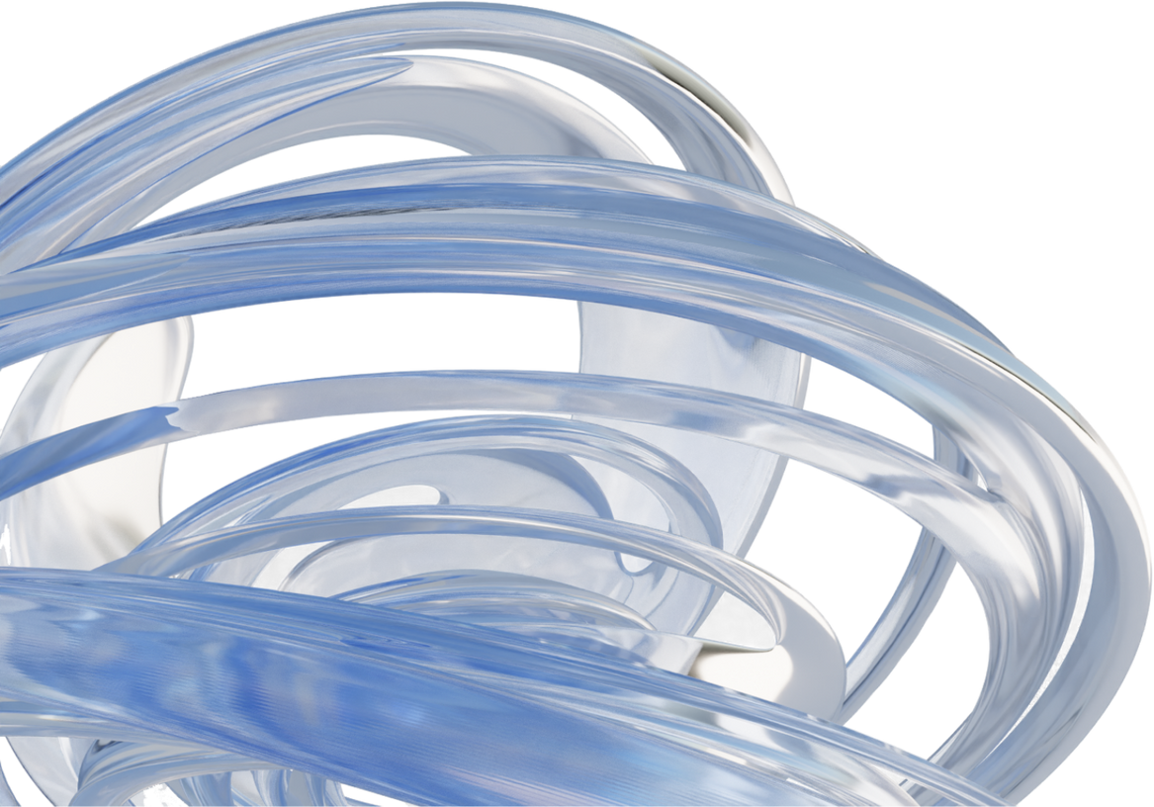
WHAT WE DO
We build a real‑time blood supply chain platform that connects donors, blood banks, hospitals, and quick‑commerce ghost stores on a single data layer.
Our system:
Tracks live blood inventory across locations
Uses supply chain optimization to pick the fastest source
Dispatches via Zepto/Blinkit riders for 10‑minute deliveries
Ensures that only authorized hospitals and blood banks can request and receive units
In short:
We turn the quick‑commerce network that delivers groceries in 10 minutes into a life‑saving blood delivery grid.

Slide 3

ABOUT US
We are a 5‑member team of first‑year LeapStart students, exploring how technology and modern supply chains can solve real healthcare problems.
This project is part of our academic learning journey, where we:
Learn the foundations of web development, cloud, and data
Study how supply chain optimization can be applied to blood logistics
Work closely with faculty mentors and industry case studies
Build a prototype platform that connects donors, hospitals, blood banks, and ghost stores on a single interface
We’re not industry engineers yet – we’re students learning to think like them, using this project as our first real step into tech‑driven healthcare.

Slide 4
VISION
To build an intelligent, hyperlocal blood supply mesh where any emergency in the city can receive the right blood unit in under 10 minutes, with full traceability from vein‑to‑vein – donor to patient.
“From fragmented stockrooms to a synchronized critical‑care supply chain.”

Slide 5

MISSION
Digitize blood inventory across hospitals, blood banks, and ghost stores
Use real‑time data and optimization algorithms to orchestrate every unit
Leverage Zepto/Blinkit micro‑fulfilment centers as medical ghost hubs
Guarantee that only verified healthcare institutions can request and receive blood
Continuously learn from data to reduce stock‑outs, wastage, and delivery time

Slide 6
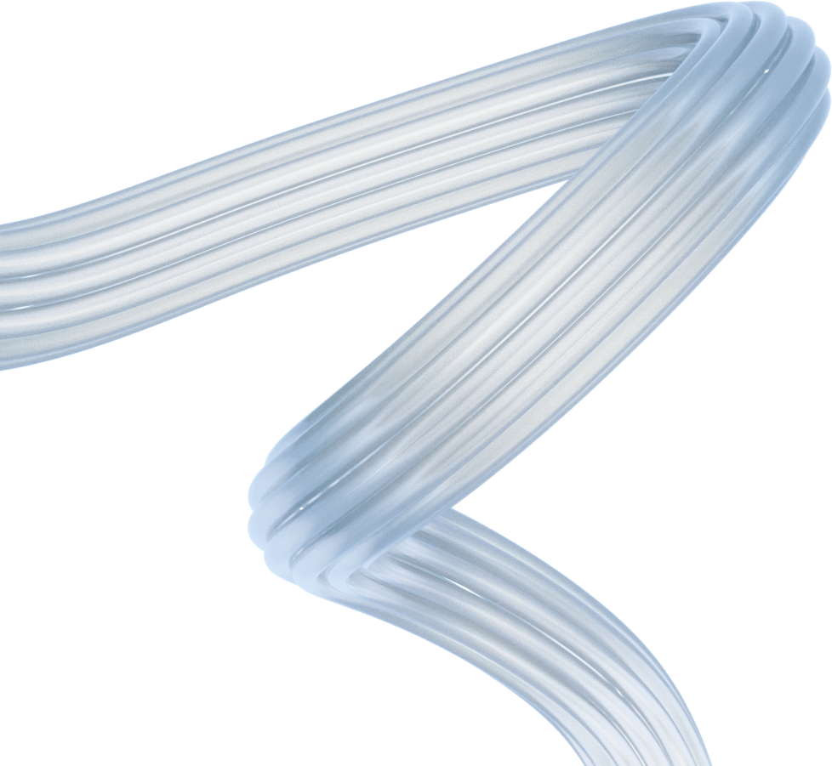
EMERGENCY BLOOD SUPPLY CHAIN
THE GAP
45–90 min
20–30%
10 min
Typical emergency blood delivery time in many urban hospitals today
Estimated share of critical cases where delayed blood availability worsens outcomes
Our target door‑to‑door delivery time using ghost‑store powered logistics
We overlay a smart supply chain layer on top of existing blood banks and quick‑commerce networks.

Slide 7
GLOBAL BLOOD DEMAND & SHORTAGE CONTEXT
Rising Blood Cancer Burden
Leukemia, lymphoma, myeloma and Hodgkin lymphoma cases have been increasing every year since at least 1990, driven by population growth, ageing and higher incidence.
Multiple myeloma cases have nearly tripled from 1990 to 2021 and are projected to reach ~321,000 new cases by 2045.
High‑income regions (e.g., Northern America) show higher age‑standardized incidence rates (ASR ~4.8 per 100,000 for myeloma).
Where Blood Is Used
The world collects ~118.5 million blood donations per year.
40% of donations come from high‑income countries that account for only 16% of the global population – they are the largest per‑capita users (surgeries, trauma care, cancer, transplants).
Low‑ and middle‑income countries (LMICs) face chronic shortages despite higher need from trauma, childbirth and anemia.
Deaths from Blood Shortages
Exact global numbers are not tracked, but shortages contribute to millions of preventable deaths annually from hemorrhage, trauma, obstetric complications and severe anemia.
In India alone, estimates suggest up to 12,000 deaths per day linked to delayed access to blood and an annual deficit of ~5 million units.
Persistent Supply Chain Gap
Voluntary donations rose by 10.7 million (2008–2018), yet LMICs still face a deficit of >100 million units each year.
Shortages drive high mortality in trauma (~40% of hospital deaths) and maternal cases (up to 35%), highlighting a global blood supply chain and distribution problem, not just a donation problem.

Slide 8
CASE STUDY
THE GOLDEN 10 MINUTES
A 28‑year‑old postpartum patient is bleeding heavily in a tier‑2 hospital.
On‑site blood stock is exhausted; the resident needs 3 units O‑negative immediately.
Traditional process:
Calls multiple blood banks manually, checks paper/Excel inventory
Sends staff by bike/car to pick up blood → 45–60 minutes
With our platform:
Resident raises a request in the Hospital Portal
System scans real‑time inventory across blood banks & ghost stores
Selects nearest Zepto/Blinkit ghost store with pre‑positioned stock
Rider dispatched instantly → ETA under 10 minutes, tracked live
The emergency becomes a standardized supply chain event, not a panic operation.

Slide 9

Blood Bank & Inventory Engine (2)
PLATFORM MODULES
Hospital Command Center
(1)
Ghost Store Logistics Connector (3)
Together, these four modules form an end‑to‑end blood logistics stack: from donors and storage to micro‑fulfilment and last‑mile delivery.
Donor Network & Analytics
(4)

Slide 10

HOW THE PLATFORM WORKS
We ingest live inventory from blood banks, hospital stock rooms, and ghost stores.
We run a real‑time matching engine that chooses the optimal source based on:
Blood type compatibility
Distance & traffic‑aware ETA
Safety stock thresholds & expiry dates
We place automated dispatch orders to Zepto/Blinkit ghost stores via secure APIs.
We expose live tracking and status updates to hospital users and blood banks.
We capture all events into a data lake for SLA monitoring, wastage analysis, and demand forecasting.
“We are not just a website – we are an orchestration layer for the blood supply chain.”

Slide 11
TECHNOLOGY STACK & HOW WE USE IT
Area | Tools | How it is used
Frontend | HTML5, CSS3, JavaScript | Build all pages and dashboards (homepage, donor form, hospital & admin portals, chatbot UI).
Authentication | Firebase Authentication | Secure Email/Password login for Hospital and Admin; handles sessions and user roles.
Database | Firebase Firestore | Store blood inventory, hospital requests, hospital profiles; enable live availability updates.
Public Health API | Rootnet Hospitals & Beds API | Fetch real‑time hospital/bed statistics by state to show a blood‑demand indicator on the homepage.
Hosting & Deployment | Vercel | Host the static frontend and deploy new versions automatically from GitHub.
Version Control | Git, GitHub | Track code changes, collaborate as a team, and connect to Vercel’s CI/CD pipeline.
Dev Environment | VS Code, LMArena | Vibe code, practice and run local tests.
Debugging & Testing | Postman, Browser DevTools | Test APIs, inspect network requests, and debug JavaScript and layout issues.

Slide 12
SMART BLOOD SUPPLY CHAIN ENGINE
Treats every blood request as a routing problem in a time‑critical network
Considers:
Hospital location and urgency
Inventory levels in:
Blood banks
Hospital stock rooms
Zepto/Blinkit ghost stores
Rider coverage and historical travel times
Optimization goals:
Minimize time‑to‑bedside while
Maintaining safety stock and minimizing wastage
Uses:
Geospatial queries (nearest facilities)
FEFO logic (use units that expire sooner first)
Configurable constraints (e.g., pediatric units, rare groups)
“From static fridges to a dynamic, algorithm‑driven cold‑chain.”

Slide 13
DATA‑DRIVEN BLOOD LOGISTICS
Capture every event:
Request created, matched, dispatched, delivered, cancelled
Build dashboards for:
Average delivery time by city and partner
% of requests served within 10 / 20 minutes
Stock‑out incidents and near‑misses
Wastage due to expiry by blood group and location
Use historical data to:
Forecast demand peaks (festivals, weekends, monsoon accidents)
Suggest repositioning of units between ghost stores
Identify rare blood group hotspots and run donor drives
“Every delivery teaches the supply chain to be smarter tomorrow.”

Slide 14
SECURE, AUTHORIZED‑ONLY BLOOD DELIVERY
Multi‑layer authentication
Firebase Auth / OAuth2 for user accounts
Institutional verification before enabling “Request Blood” role
Role‑based access control (RBAC)
Donor, Hospital, Blood Bank, Admin, Partner roles
Delivery constraints
Only authorized hospitals & blood banks can:
Create requests
Receive dispatches at registered addresses
Auditability
Immutable logs of:
Who requested what, from where, at what time
Which blood bag ID was delivered by which rider
Compliance‑ready
Design aligned with national blood bank regulations
Flexible policy engine to adapt to local rules

Slide 15
ROADMAP
Q1
Q2
Q3
PILOT FOUNDATIONS
SCALE & AUTOMATION
ADVANCED ANALYTICS & MULTI‑CITY
Connect 1–2 hospitals & 1 blood bank
Manual + semi‑automated integration with 1 ghost store partner
Validate 10‑minute delivery SLA in a single city zone
Basic dashboards for delivery time & stock‑outs
Add more hospitals and blood banks in the city
Fully automated dispatch flows with Zepto/Blinkit APIs
Enhance optimization engine (traffic, time‑of‑day patterns)
Introduce donor campaigns for rare groups based on data
Expand to multiple cities / clusters
ML‑based demand forecasting and dynamic safety stock levels
Integrate with hospital HIS/LIS systems (HL7/FHIR APIs)
Launch regulator/health‑authority dashboards

Slide 16
TEAM
Shiva Kumar Bashamoni
Abhishek
Singh
Ashwith Thatipally
Frontend
UI/UX
UI/UX
Saathvik Kellampalli
Akash Aakula
Backend & Deployment
Testing

Slide 17
WHY THIS PLATFORM WINS
Transforms a manual, phone‑based process into a real‑time digital supply chain
Reuses existing quick‑commerce ghost store infrastructure instead of building new logistics from scratch
Provides end‑to‑end visibility: inventory, ETA, rider location, and clinical status
Reduces wastage by applying FEFO and demand forecasting
Creates a compliant, audit‑ready system that regulators can trust and monitor
“From guesswork to orchestrated critical‑care logistics.”

Slide 18
NEXT STEPS
Identify pilot partners:
1–2 hospitals, 1 blood bank, 1 ghost store cluster
Define baseline metrics:
Current average delivery time
Stock‑out frequency, wastage levels
Run a 3‑month pilot and measure:
% deliveries under 10 minutes
Reduction in manual calls and coordination time
Improvement in utilization of existing blood stock
Co‑design:
Regulatory reporting views
Hospital‑specific workflows & integrations
“Let’s turn the city’s grocery supply chain into a life‑saving blood supply network.”

Slide 19
With good data, intelligent routing, and hyperlocal ghost‑store logistics,
health systems can turn the city’s grocery supply chain into a
life‑saving critical‑care supply chain –
delivering the right blood unit to the right patient in under 10 minutes.

Slide 20
OUR WORK
GitHub: https://github.com/broskell/Blood-Bank
Live demo: https://blood-bank-xi-eight.vercel.app
Institute: LeapStart School of Technology

Slide 21
THANK YOU
RAPID BLOOD SUPPLY CHAIN PLATFORM
“From fragmented fridges to a synchronized 10‑minute blood supply chain.”

